Slide 1

Uber Supply-Demand Gap Case Study
By – Sagnik Banerjee
Notes:
To change the image on this slide, select the picture and delete it. Then click the Pictures icon in the placeholder to insert your own image.

Slide 2
Problem Statement -
This data set is a masked data set which is similar to what data analysts at Uber handle. Add your second bullet point here
Visually identify the most pressing problems for Uber.
Find out the gap between supply and demand and show the same using plots.
Find the time slots when the highest gap exists
Find the types of requests (city-airport or airport-city) for which the gap is the most severe in the identified time slots
What do you think is the reason for this issue for the supply-demand gap? Write the answer in less than 100 words. You may accompany the write-up with plot(s).
Recommend some ways to resolve the supply-demand gap.

Slide 3
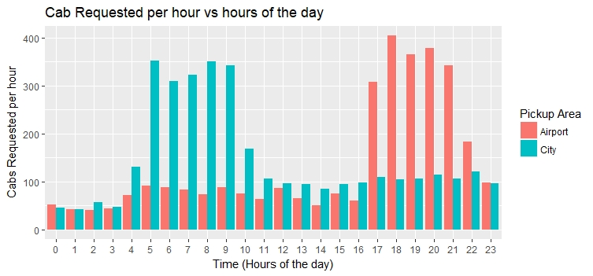
Objective #1 - Visually identify the most pressing problems for Uber
Will plot the first graph to find number of requests fetched by Uber per hour During different times of the day. Pickup points to be projected in two different colors. The data set is ready for visualization & inferring insights out of it. Column for day categorization - Day category and the column used for hour is u2.timeo.

Slide 4
Explanation – Objective #1
There's a clear complimentary relationship between the airport & city pick-up requests.
Clearly, there is NEGATIVE CO-RELATION BETWEEN airport & city pick-up Requests. The count of cab requests from the airport is too high post 16:00 – 23:00 hrs. Similarly, complimenting it, the count of cab requests at the city is too high from 04:00 to 11:00hrs for the days considered for data sampling.
Ideally, this would mean that there should not be any problem but upon looking more deeply, important insights come to the forefront

Slide 5
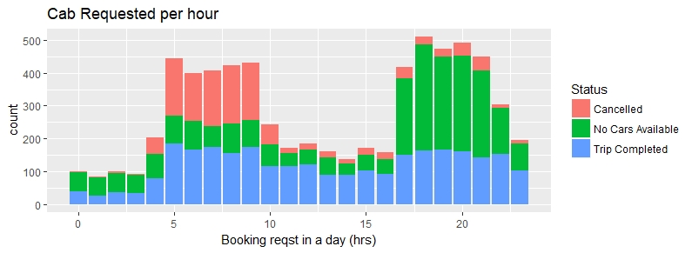
Objective #2 - Find out the gap between supply and demand and show the same using plots
Visual cues are gathered to Solve Results Expected point #1 - Visually identify the most pressing problems for Uber.
The graph is plotted so as to find the frequency of occurrence of 2 most difficult problems at hand - cancelled / no cars.

Slide 6
Objective #2 - Find out the gap between supply and demand and show the same using plots
After plotting the graph named - rhrs_status (as mentioned in the R file), we can easily say that the frequency of occurrence of no cars available during evening increases as opposed to cancelled trips in the morning time, is what hurting the Uber business

Slide 7
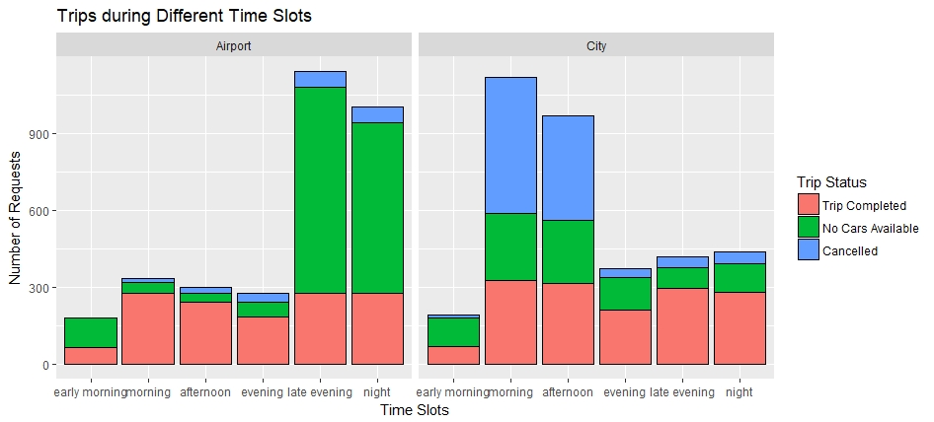
Objective #2- Find the time slots when the highest gap exists
The graph below shows the highest gap exists during morning, afternoon in the city area & during late evening ,night time in the airport region

Slide 8
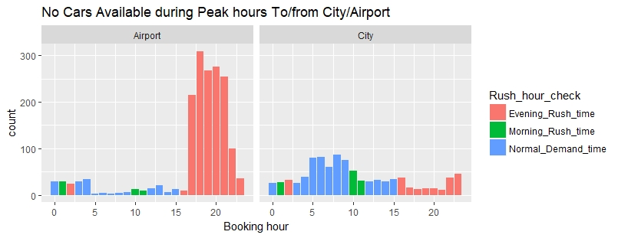
Objective #2 - Find the types of requests (city-airport or airport-city) for which the gap is the most severe in the identified time slots
For finding this, two different graphs are used. The graph below shows No Cars available during peak hours from city/ airport

Slide 9
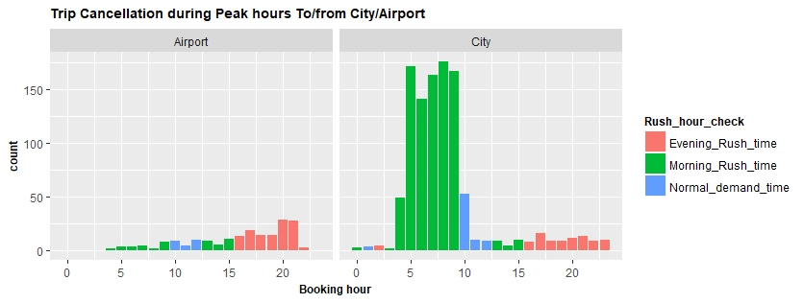
Objective #2 - Find the types of requests (city-airport or airport-city) for which the gap is the most severe in the identified time slots
For finding this, two different graphs are used. The graph below shows Cancelled cars during peak hours from city/ airport

Slide 10
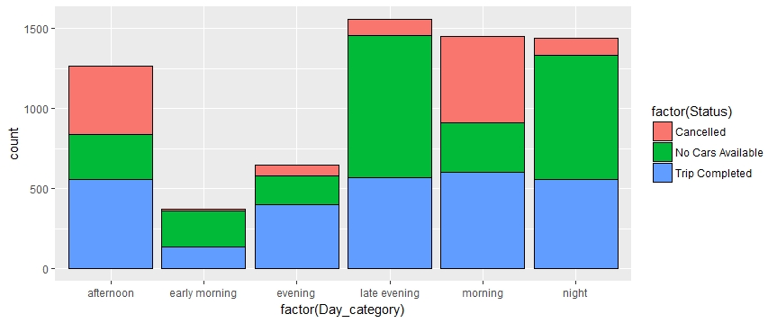
Objective #2 - Find the types of requests (city-airport or airport-city) for which the gap is the most severe in the identified time slots
An aggregated view and previous 2 graphs goes on to show that Airport – city – No Cars Available during evening rush hour is the one for which the gap is most significant.

Slide 11
Objective #3- What do you think is the reason for this issue for the supply-demand gap? Write the answer in less than 100 words. You may accompany the write-up with plot(s).
The insights gained goes on to prove the hypothesis that during evening, the number of incoming flights into the Airport > the number of flights leaving the Airport. So obviously the number of cabs leaving the Airport > number of incoming cabs. Hence, the Supply – Demand Gap.
Similarly, during morning, the hypothesis is confirmed that the umber of outgoing flights > the number of incoming flights. It was established that the Airport is outside the city. Hence, the time to travel to the airport & spending idle time there (incoming flights numbers are less) is what deters a driver to leave city premises & take an airport ride.

Slide 12
Objective#4 - Recommend some ways to resolve the supply-demand gap.
Increase the fare for customers going from City to Airport during Morning Rush hours, provide the drivers a higher cut for these trips.
Make a Uber parking in Airport, allow drivers to park for free. Higher rates for rides from airport to city during Evening rush hours. Accordingly, pay more to drivers for these trips. Someone who is nearby to airport area can come & park for free. Free & safe parking might enable 24 X 7 supply at airports.

